Slide 1
Characterization of analogue ASIC for L1 Trigger Decision. CTA. Part 2.
Offset Difference Problem
Analog Offset measures review
Analysis of good AO ASICs selection.
Conclusions
Open Questions
Problems from previous analysis: Suspicious structure for fit offset and difference fit offset-analog offset correlation.

Slide 2
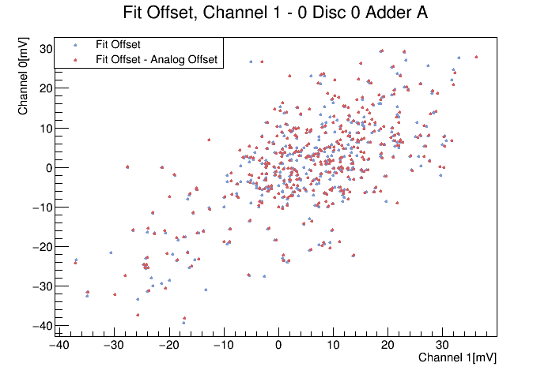
Offset Difference Problem
Analog Offset measures review
Offset Difference Problem
Analog Offset measures review
Analysis of good AO ASICs selection.
Conclusions
A suspicious structure in the correlation between channels for the Fit Offset and the Offsets difference was spotted in previous analysis.
                Most points seemed to be displaced a too short distance.
                The result was a too similar structure for channel-channel correlation for Fit Offset and FO-AO difference.
Problem Source: ASICs from #101 to #451 has too low measures of Analog Offset in the Quality Control test (Values similar to 0, -0,1, -0,3, 1...[mV]) in comparison with the first 39 ASICs (which have values up to several tens of mV, positive and negative).

Slide 3
Offset Difference Problem
Analysis for good AO ASICs selection
Offset Difference Problem
Analog Offset measures review
Analysis of good AO ASICs selection.
Conclusions
ASICs from #61 to #100 have good measures of Analog Offset. The same analysis made previously for all ASICs is performed now only for this 39 ASIC selection.
In general it has been noted:
      The problem of the correlation structure dissapears.
      There is still correlation for the fit offset.
      Correlation observed for the offsets difference is not that strong.
      Adders are still responsible for the offset.
      With this small selection, histograms offer very poor information.

Slide 4
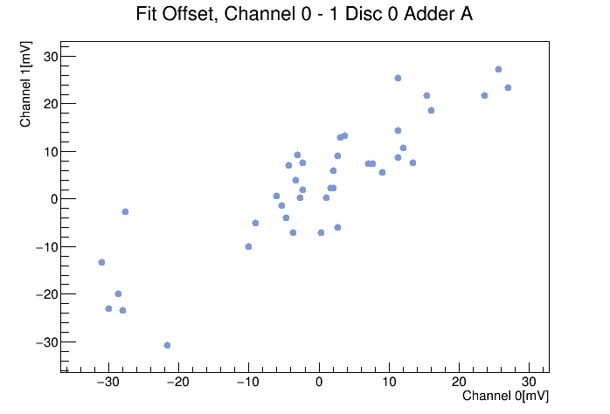
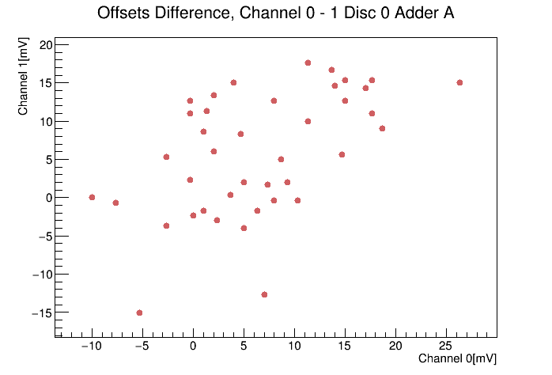
Offset Difference Problem
Analysis for good AO ASICs selection
Offset Difference Problem
Analog Offset measures review
Analysis of good AO ASICs selection.
Conclusions
Figure 2: Fit Offset Channel-Channel correlation (left) and offsets difference FO-AO Channel-Channel correlation (right) for ASICs from #61 to #100.

Slide 5
Offset Difference Problem
Analysis for good AO ASICs selection
Offset Difference Problem
Analog Offset measures review
Analysis of good AO ASICs selection.
Conclusions
Figure 2: Fit Offset Channel-Channel correlation (left) and offsets difference FO-AO Channel-Channel correlation (right) for ASICs from #61 to #100.

Slide 6
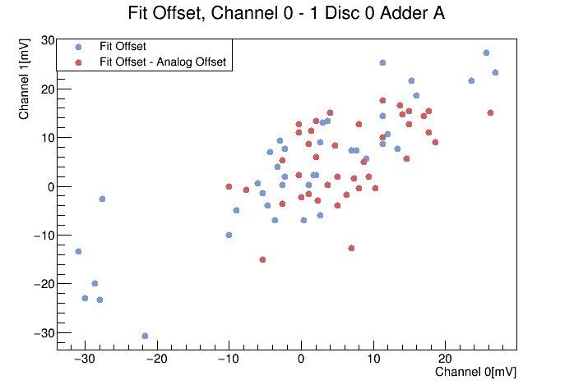
Offset Difference Problem
Analysis for good AO ASICs selection
Offset Difference Problem
Analog Offset measures review
Analysis of good AO ASICs selection.
Conclusions
Figure 3: Fit Offset Channel-Channel correlation and offsets difference FO-AO Channel-Channel correlation for ASICs from #61 to #100. It can be observed that there exist a linear correlation in the offset plus the structures are different. In the difference, it can be also a correlation but is not that clear.

Slide 7
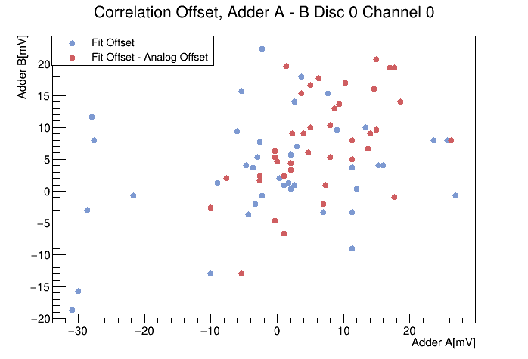
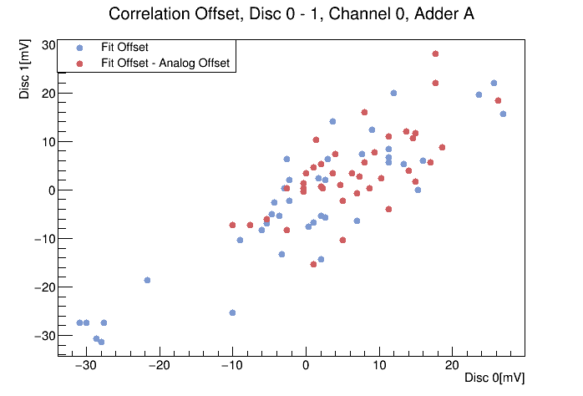
Offset Difference Problem
Analysis for good AO ASICs selection
Offset Difference Problem
Analog Offset measures review
Analysis of good AO ASICs selection.
Conclusions
Figure 4: Fit offset and offsets differnc correlation between adders (left) and discriminators (right). No correlation is observed between adders which implies that they are responsible for the offset in the circuit.

Slide 8
Offset Difference Problem
Analysis for good AO ASICs selection
Offset Difference Problem
Analog Offset measures review
Analysis of good AO ASICs selection.
Conclusions
Some issue must have been occured during the automatic test from ASIC 101 to 451, since analog values doesn't seem correct in comparison with the typical measures for the first 39 ASICs.
It may be required to repeat the masures to find out where the problem could come from.
It is needed to repeat and rethink the analysis once all the measures are reviewed.

